Slide 1
A Study Of The Book Of Revelation
October 31, 2021

Slide 2
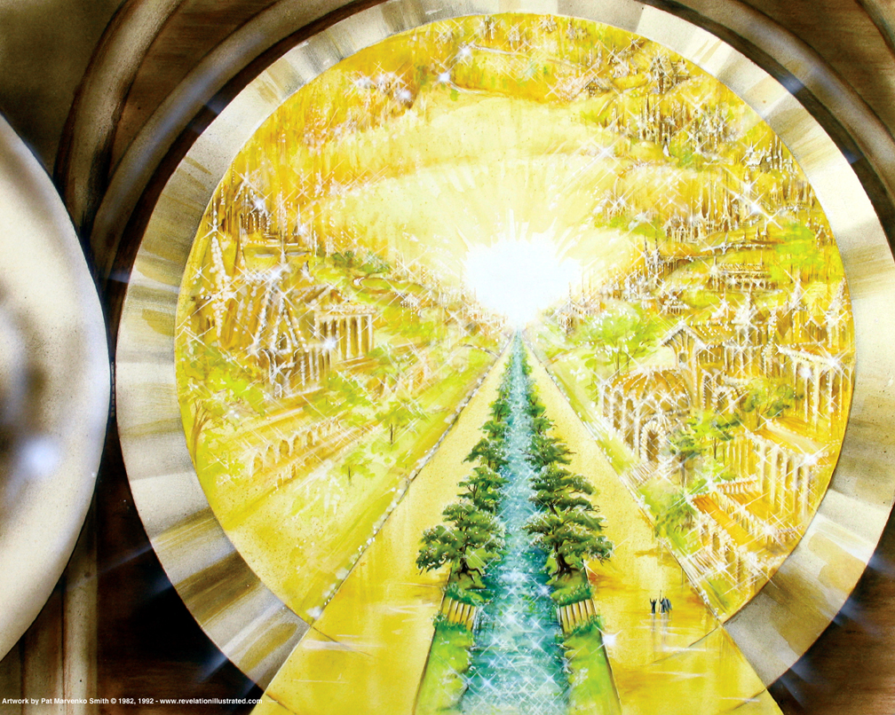
Book of Revelation: Chapter 22
Wrapping Up The Apocalypse
“The River of Life”

Slide 3

Revelation 22:1
Revelation 22
“And he showed me a river of water of life, bright as crystal, proceeding out of the throne of God and of the Lamb,”

Slide 4
Satan is the merchant of death! God is the giver of life!
Revelation 22
The book of life has been mentioned 8 times.
The water of life 3 times.
The tree of life 3 times.
The crown of life 1 time.

Slide 5
Revelation 22:2
Revelation 22
“in the midst of the street thereof. And on this side of the river and on that was the tree of life, bearing twelve (manner of) fruits, yielding its fruit every month: and the leaves of the tree were for the healing of the nations.”

Slide 6
Revelation 22:3
Revelation 22
“And there shall be no curse any more: and the throne of God and of the Lamb shall be therein: and his servants shall serve him;”

Slide 7
Revelation 22:4
Revelation 22
“and they shall see his face; and his name (shall be) on their foreheads.”
Revelation 13:16ff

Slide 8
Revelation 22:5
Revelation 22
“And there shall be night no more; and they need no light of lamp, neither light of sun; for the Lord God shall give them light: and they shall reign for ever and ever.”

Slide 9
The garden, a place of healing – River of Life
Revelation 22
In these first five verses, there is apparent allusion to the first few chapters of Genesis:
Tree of Life (Genesis 2:9)
River (Genesis 2:10)
Absence of sin (Genesis 3:22-24)
Presence of God (Genesis 3:8)
Three basic things necessary to life
Water, food, and health

Slide 10
The garden, a place of healing – Tree of Life
Revelation 22
Tree of life has 12 crops of fruit annually
Fruit is born regularly each month
Fruit produces life
Leaves are for healing
God richly and abundantly supplies every need for eternal life!

Slide 11
The garden, a place of healing – No More Curse
Revelation 22
Even as sin was driven out of the original Garden of Eden, so the “curse” of sin – with its pain, sorrow, and death will be absent in heaven!
We will be his servants – serving Him there
The throne of God and the Lamb – Father and Son in unison.
The throne of God and of the Lamb points to their joint occupancy of the throne, as implied earlier (3:21; 12:5; 22:1).

Slide 12
Shall See His Face
Revelation 22
Moses first expressed a yearning to see God (Exodus 33:17-23)
Philip in NT (John 14:8)
Not possible while man lived on earth (John 1:18; 1 John 4:12)
Desire realized in heaven. Clearly identified as being His –
Their names engraved on foreheads! (3:12; 7:3; 14:1). They shall see Him as He is because they will be forever in His presence (1 John 3:1-2)

Slide 13
No Night There
Revelation 22
Repeats God is the light of the city (21:23)
Length of His reign – forever and ever
Faithful Christians reign with Him on earth (Romans 5:17; Revelation 5:10)
Following judgment – reign in heaven
This answers man’s longing to know about future life
Perfect protection, perfect fellowship, provisions, and service to God

Slide 14
Revelation 22:6
Revelation 22
“And he said unto me, These words are faithful and true: and the Lord, the God of the spirits of the prophets, sent his angels to show unto his servants the things which must shortly come to pass.”

Slide 15
Words are Faithful and True
Revelation 22
“Everything men have searched for in the flesh, God has promised to the faithful.
“Hope of better things to come anchors the soul (Heb. 6:19).
“Therefore, here is the fullest description of that hope often referred to by other New Testament writers (Rom. 8:18-25; 1 Cor. 15:19-58; 2 Cor. 4:16-5:4; Heb.11:13- 16; 1 Pet. 1:3-5).”
(Robert Harkrider, Revlation, Truth Commentaries, page 314)

Slide 16
Words are Faithful and True
Revelation 22
The message John has received is trustworthy
Book opens and closes with – “must shortly come to pass” (2:5, 16; 3:11).
Three times the expression is found in the closing of the book (22:7, 12, 20).
If these things have not yet occurred – there was no comfort to those who were addressed!
Christ is certainly coming again.
This expression may also serve as a warning regarding the manner of His second coming to judge the world (16:15; 1 Thessalonians 5:1-3; 2 Peter 3:10).

Slide 17
Revelation 22:7
Revelation 22
“And behold, I come quickly. Blessed is he that keepeth the words of the prophecy of this book.”

Slide 18
Beatitudes of Revelation
Revelation 22
Blessed is he that reads (1:3)
Blessed is he that hears (1:3)
Blessed is he keeps those things written (1:3)
Blessed are those who die in the Lord (14:13)
Blessed are those who wash their garments (16:15)
Blessed are those called to the marriage supper (19:9)
Blessed are all who have part in first resurrection (20:6)
Blessed these who keep words of prophecies (22:7)
Blessed who obey His commandments (22:14)

Slide 19
Revelation 22:8
Revelation 22
“And I John am he that heard and saw these things. And when I heard and saw, I fell down to worship before the feet of the angel that showed me these things.”

Slide 20
Revelation 22:9
Revelation 22
“And he saith unto me, See thou do it not: I am a fellow-servant with thee and with thy brethren the prophets, and with them that keep the words of this book: worship God.”

Slide 21
Revelation 22:10
Revelation 22
“And he saith unto me, Seal not up the words of the prophecy of this book; for the time is at hand.”

